Slide 1
Open Science Infrastructure in Modeling
Chair: Claudio Corti
Panelists: Michael Hirsch, Ron Caplan, Gian Luca Delzanno

Slide 2
Finding models & simulation outputs
How: “Metadata, metadata, metadata”
What are we looking for?
Model
Model run configuration
Simulation output
Where to look for?
Reuse/expand already existing data models? CDF/ISTP, PDS, SPASE, IVOA, etc
How to reach consensus on metadata standard(s)? Who should be in charge?
opeclipart.org

Slide 3
Storing simulation outputs
How large can simulation outputs be?
What is actually useful to store?
How to access simulation outputs?
File transfer, local analysis vs cloud access, remote analysis
What are the challenges for long-term storage?
How long is long enough?
What are current storage solutions?
File formats
Simulation output repositories

Slide 4
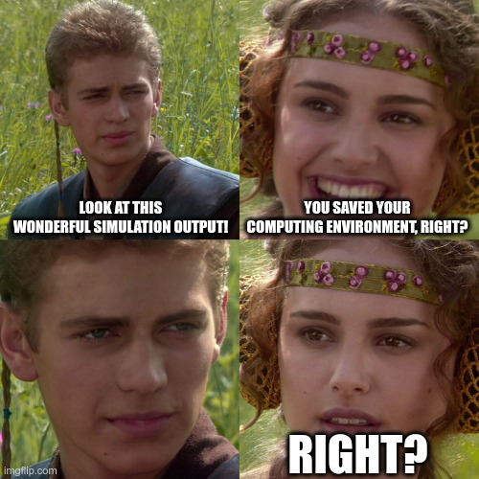
Reproducing simulation outputs
Are containers enough to ensure reproducibility, especially long-term?
How long is long enough?
What is the burden for modelers and/or users to containerize models/model runs?

Slide 5
Join the
discussion

